Slide 1
Week 10
Alexey V. Zimin
JHU BME 580.417/707

Slide 2
Lab #5: Jaccard similarity
In this lab assignment you will write set of functions to compute Jaccard similarity between genomes based on comparison of their fixed size sketches. Due November 10th at 8:00pm
The goal is to write a Python script named jaccard.py containing the following functions:
reverse_complement(seq): returns reverse complement of sequence seq; reuse this function from Lab #2.
compute_num_value (seq): returns minimum numerical value between forward and reverse versions of the sequence seq; reuse this function from Lab #2.
(G:30pt,U:30pt) load_fasta_to_dict(fasta_path): parses fasta file fasta_path and returns a dictionary where keys are names of fasta sequences, and values are the genome sequences
(G:30pt,U:30pt) compute_sketch(seq_dict,k,s): returns a sketch, which is an array of s smallest distinct integer k-mer values sorted from smallest to largest for all k-mers of size k in all genome sequences in seq_dict
(G:30pt,U:40pt) compare_sketches(sketch1,sketch2,s): computes Jaccard similarity for sketches sketch1 and sketch2 of size s, returns a floating-point number between 0 and 1.
Graduate students only: (10pt) download two HIV virus sequences from NCBI: accessions GCA_003109165.1 and GCA_003109225.1; use s=20, vary K from 6 to 101, plot Jaccard(K,s). At what value of K Jaccard similarity becomes equal to 0? Upload a figure containing plot of Jaccard(K,s) as function of K. Add a box with value of K’ where Jaccard (K’,20)==0

Slide 3
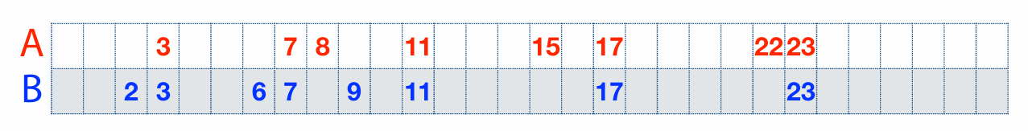
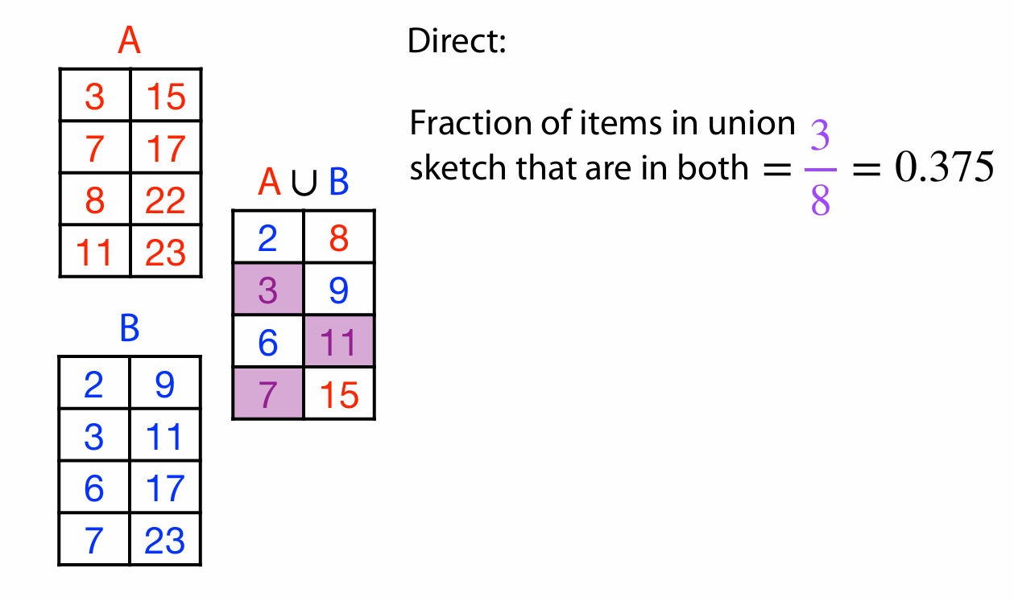
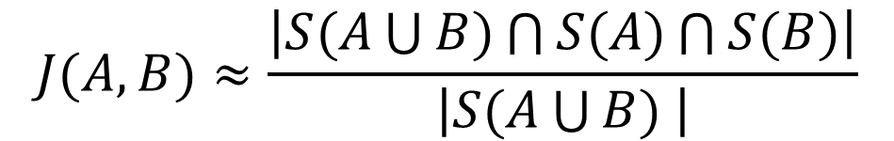



Jaccard similarity example
$$S(A)$$
$$S(A\bigcup{B)}$$
$$S(B)$$
$$J(A,B)≈\frac{\left|S(A\bigcup{B)\bigcap{S(A)}\bigcap{S(B)}}\right|}{\left|S(A\bigcup{B) }\right|}$$

Slide 4
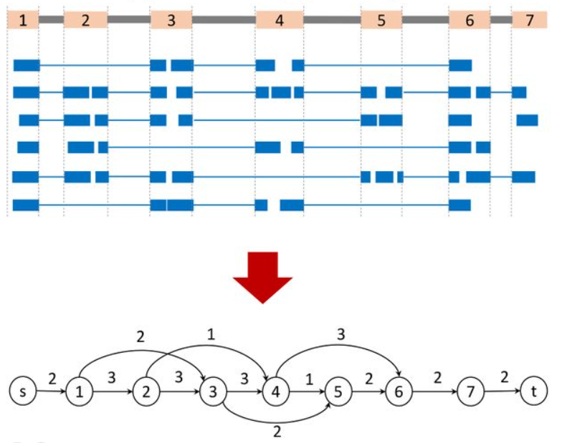
Assembly of aligned RNA-seq data
Image credit: https://www.biorxiv.org/content/10.1101/2024.02.09.579380v1.full
Use spliced alignments
Typically faster and more accurate
Build splice graph:
Nodes are exons
Edges are introns
Edge weight is the number of spliced reads
Remember that these data represent several linear transcripts

Slide 5
Assembly of aligned RNA-seq data
Image credit: https://www.biorxiv.org/content/10.1101/2024.02.09.579380v1.full
Can be solved as a variant of maximum flow problem
The problem: distribute paths(flows) between several linear transcripts
Algorithm:
Compute the path of heaviest coverage
Remove the reads used in the path
iterate

Slide 6
Assembly of aligned RNA-seq data
Image credit: https://www.biorxiv.org/content/10.1101/2024.02.09.579380v1.full
Path: 1-2-3-4-6 f=3

Slide 7
Assembly of aligned RNA-seq data
Image credit: https://www.biorxiv.org/content/10.1101/2024.02.09.579380v1.full
Path: 1-2-3-4-6 f=3
Remove reads used in the first path
Second path:1-3-5-6-7 f=2

Slide 8
Assembly of aligned RNA-seq data
Image credit: https://www.biorxiv.org/content/10.1101/2024.02.09.579380v1.full
Path: 1-2-3-4-6-7 f=3
Remove reads used in the first path
Second path:1-3-5 f=2
Remove reads used in the second path
Third path: 2-4-5 f=1

Slide 9
Evaluating transcript assembly
We want to compare the assembly output against a benchmark transcriptome where correct sequences of all transcripts are known.
Limitations of using a known reference transcriptome:
variability in the transcriptome (e.g. among e.g. cell types) makes it impossible to determine whether sequences from the reference that are missing from the assembled transcriptome are due to assembly errors, or whether they were not expressed in the library sequenced
transcriptome sequences may also vary between the individual under study and the reference

Slide 10
Common reference annotation databases

Slide 11
Benchmark transcriptome
We don’t have RNA-seq data from a transcriptome where all transcript sequences and expression patterns are known => simulate the sequencing of a given benchmark transcriptome to comprehensively assess all of the assembly errors.
Tools that can generate simulated reads modeling the errors and biases introduced by
short Illumina reads: RSEM, FluxSimulator, Polyester
long third- generation sequencing reads: PBSIM, Trans-NanoSim
Using simulated RNA-seq data allows the quantification of each of the following categories:
correctly assembled sequences (true positives or TPs)
sequences that are assembled with errors (false positives or FPs)
sequences in the reference that are missing from the assembly (false negatives or FNs)

Slide 12
Transcriptome assembly metrics
P – positive
N – negative
☺ TP – True Positive, we found correct transcript
☺ TN – True Negative, we did not find transcript where there was none
☹ FP – False Positive, we found transcript where there was none
☹ FN – False Negative, we missed transcript
P = TP + FN
N = TN + FP

Slide 13
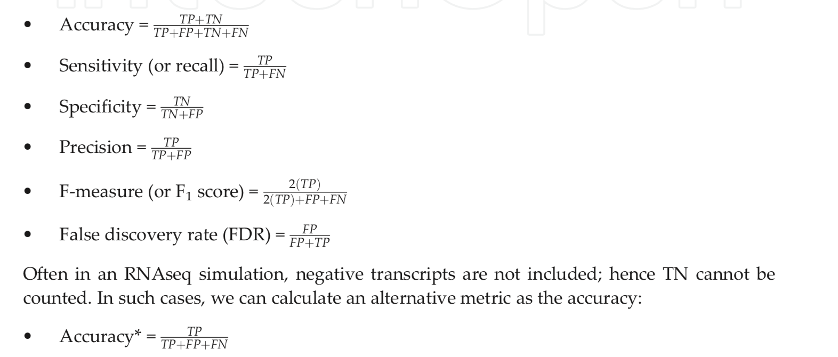
Assembly metrics based on benchmark
P = TP + FN
N = TN + FP

Slide 14
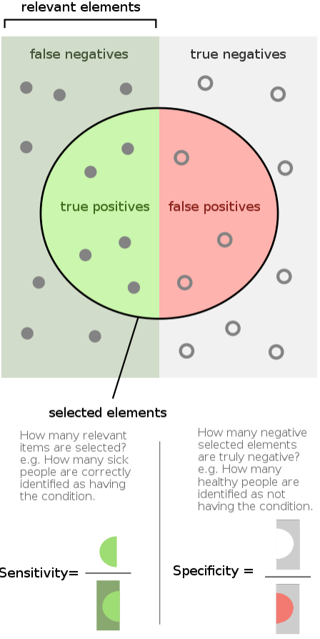
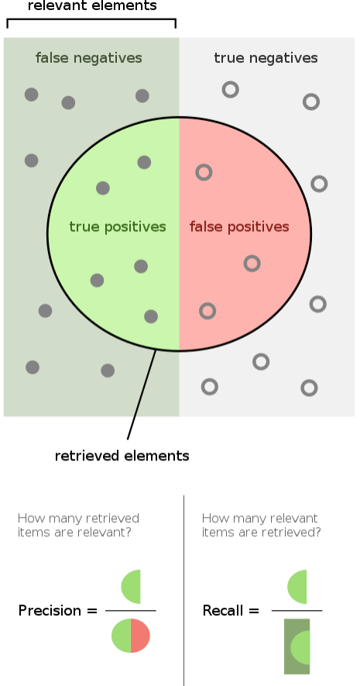
Measures of correctness
Sensitivity (Recall), Specificity and Precision
Image credit: Wikipedia

Slide 15
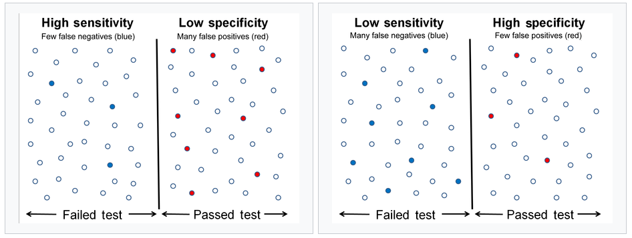
Sensitivity and Specificity

Slide 16
Intron chain
Intron chain is the set of numbers corresponding to the start and end exon coordinates for spliced exons
Intron chain also records the strand (+, or forward) or (-, or reverse)
Intron chain here is (+) i₁, i₂, i₃, i₄, i₅, i₆
Ignores start and end coordinates
Coding start
Coding stop
i₁
i₂
i₃
i₄
i₅
i₆

Slide 17
Nucleotide level accuracy
TN
FN
TP
FP
TN
FN
TP
FN
TN
REALITY
ASSEMBLY
Sensitivity:
Precision:

Slide 18
Exon level accuracy
WRONG EXON
CORRECT EXON
MISSING
EXON
REALITY
ASSEMBLY
Exon Sensitivity
Exon Precision
“Junction ends” must match exactly, beginning or end do not!

Slide 19
Transcript level accuracy
< 80%
REALITY
ASSEMBLY
WRONG!
Same INTRON CHAIN => CORRECT!
CORRECT!

Slide 20

gffread, gffcompare and trmap
gffread, gffcompare and trmap
- a fast tool for verification, filtering and conversion of the most popular annotation file formats (GTF, GFF3, BED) and for quick extraction of transcript sequences from the genome sequence.
FASTA:
GFF/BED:
gffread -w
http://ccb.jhu.edu/software/stringtie/gff.shtml

Slide 21
gffread, gffcompare and trmap
gffread, gffcompare and trmap
- a tool for merging and tracking transcript structures across multiple samples and comparing them to a reference annotation.
exon 1
exon 2
exon 3
exon 4
Reference
transcripts
isoform 1
isoform 2
Sample 1
transfrags
Sample 2
transfrags
Merged
transcripts
http://ccb.jhu.edu/software/stringtie/gff.shtml

Slide 22
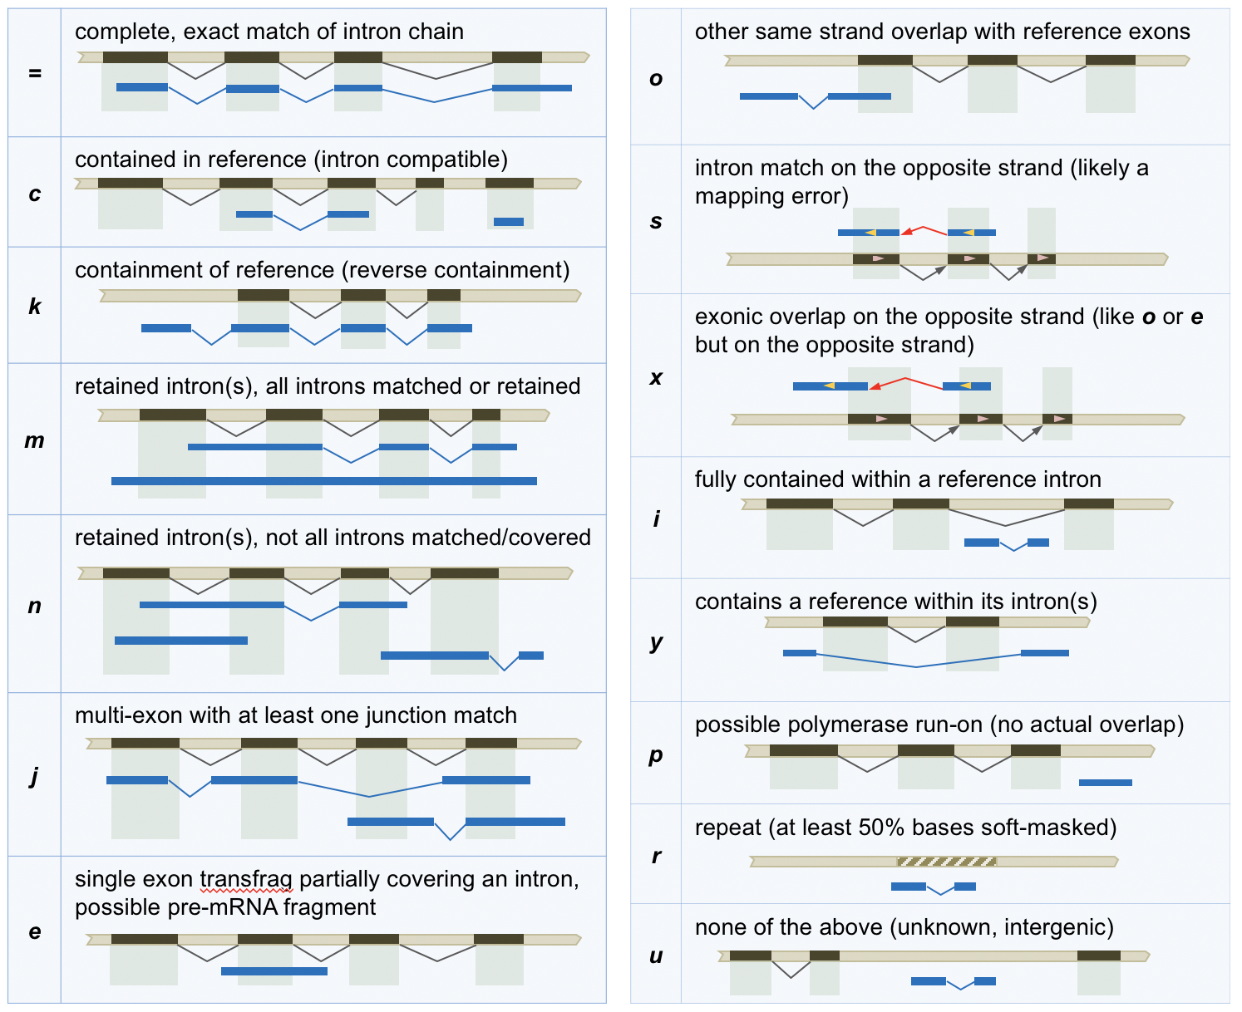
gffread, gffcompare and trmap
gffread, gffcompare and trmap
- a tool for merging and tracking transcript structures across multiple samples and comparing them to a reference annotation.
http://ccb.jhu.edu/software/stringtie/gff.shtml

Slide 23
gffread, gffcompare and trmap
gffread, gffcompare and trmap
- designed for large scale overlap analysis of streaming transcript prediction data (millions of transcripts) with a reference annotation data set; it performs detection and classification of all the overlaps found between the streamed transcripts and the reference annotation transcripts.
http://ccb.jhu.edu/software/stringtie/gff.shtml

Slide 24
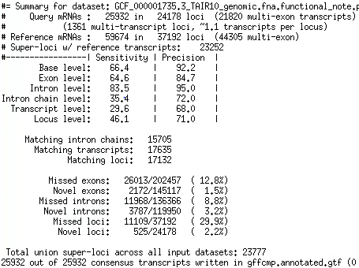
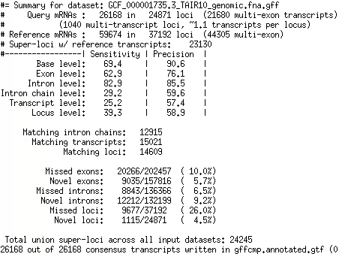
gffcompare of two annotations

Slide 25
gffcompare of two annotations

Slide 26
Ab initio gene finding
Transcriptome sequencing data does not provide comprehensive picture of expression – not all transcripts are expressed in all cells at the same time:
Sequence many different cells under many conditions (expensive)
Supplement transcriptome sequencing data with an ab initio gene finding algorithm to find transcripts that a not expressed
Assembled transcripts have errors:
Use machine learning algorithms to detect errors in assembled transcripts
Machine learning:
Positional Weights/Markov chain/Hidden Markov Models
Convolution Neural Networks?

Slide 27
Machine learning algorithms
Protein coding and non-coding sequences have different patterns of letters
Spliceosome does not just cut out introns at GT-AG, it recognizes longer patterns around splice sites
We can look for the patterns with machine learning algorithms
We can model and test the patterns with:
Positional Probabilities or Positional Weights
Markov chains
Hidden Markov Models

Slide 28
Markov chains and HMMs
We can use Positional Probabilities and Markov chains to test whether the sequence patterns around features (such as splice sites GT-AG) correspond to what is expected, which allows us to:
Look for new features
Test for correctness of existing features obtained from the data
We will consider application of Positional Probabilities and Markov chains to splice site prediction/validation
We can use HMMs to locate regions of sequence that appear to have different properties (coding vs. non-coding)

Slide 29
Positional Probabilities
Positional probabilities is the most straightforward approach to detecting and testing sequence patterns
Positional probabilities simply quantify the probabilities of observing A,C,G,T at a certain location in genomic sequence

Slide 30

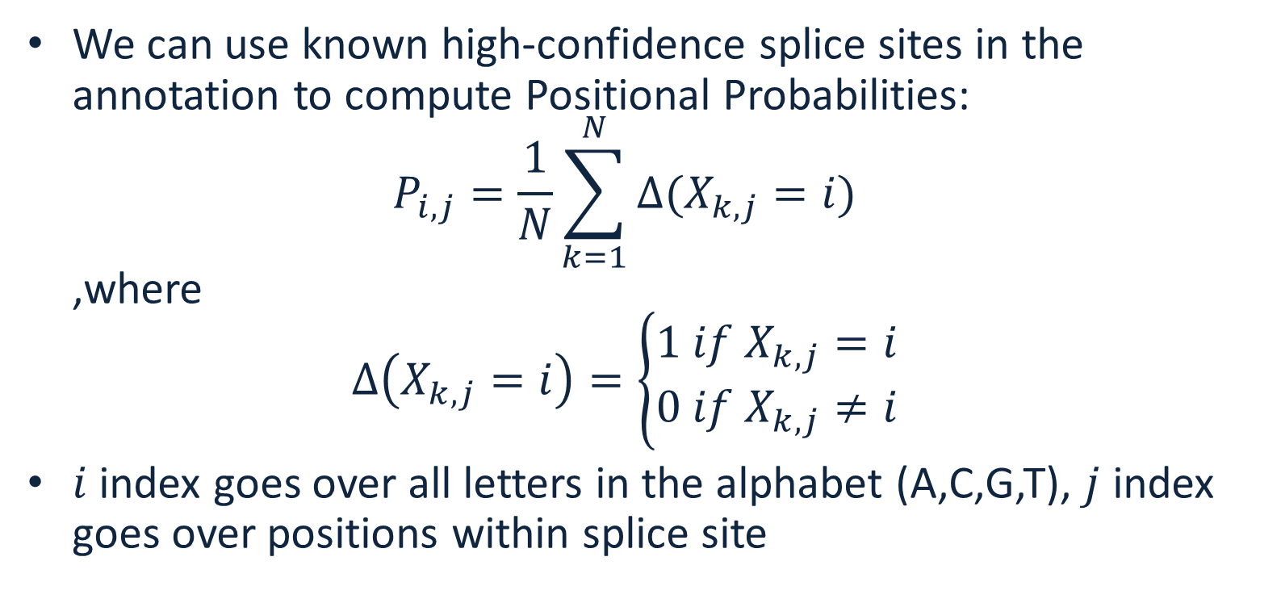
Positional probabilities
We can use known high-confidence splice sites in the annotation to compute Positional Probabilities: $P_{i,j}=\frac{1}{N}\sum_{k=1}^{N}{∆(X_{k,j}=i)}$ ,where $∆\left(X_{k,j}=i\right)=\left\{\begin{matrix}1 if{ X}_{k,j}=i \\ 0 if{ X}_{k,j}≠i\end{matrix}\right.$
$i$ index goes over all letters in the alphabet (A,C,G,T), $j$ index goes over positions within splice site

Slide 31
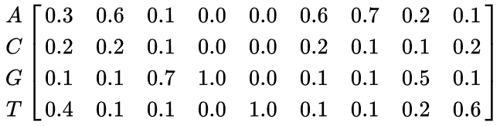

Example
Given DNA sequences:
The Positional Probability Matrix (PPM) is
Computing these probabilities from the data is the learning part
$P_{i,j}=$

Slide 32
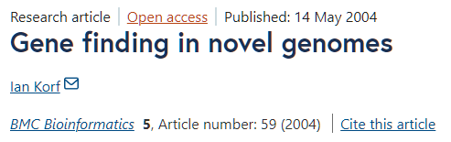
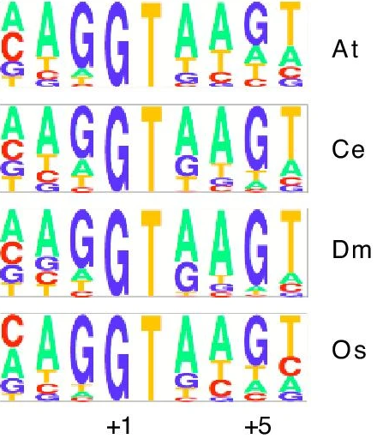
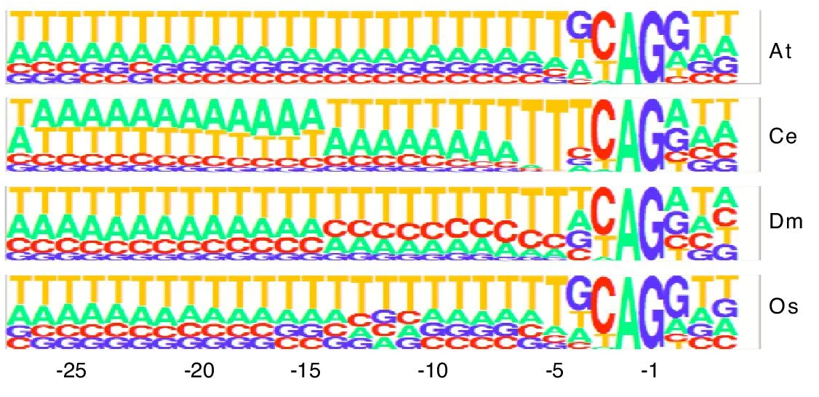
Splice site patterns
Donor (GT)
Acceptor (AG)

Slide 33

Using PWM to evaluate pattern
We can calculate the probability of a sequence given a PPM, by multiplying the relevant probabilities at each position. For example, the probability of the sequence S = GAGGTAAAC can be calculated:
Compare this to the probability of a random sequence (all probabilities are 0.25) 0.25^9=0.0000038
${P_{i,j}}_{ }=$
$${p(S|P}_{i,j})=.1∗.6∗.7∗1∗1∗.1∗.7∗.2∗.2=0.0007056$$

Slide 34
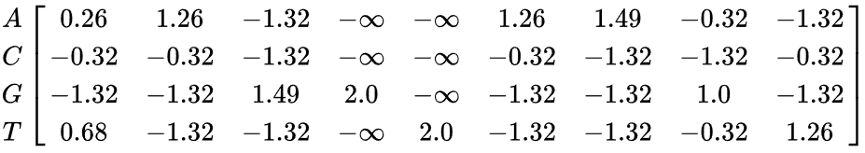
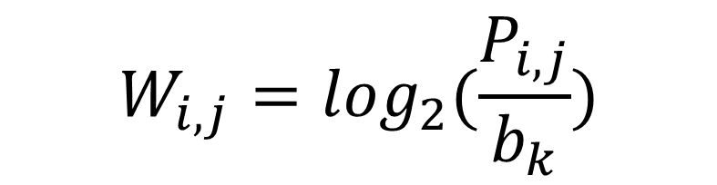
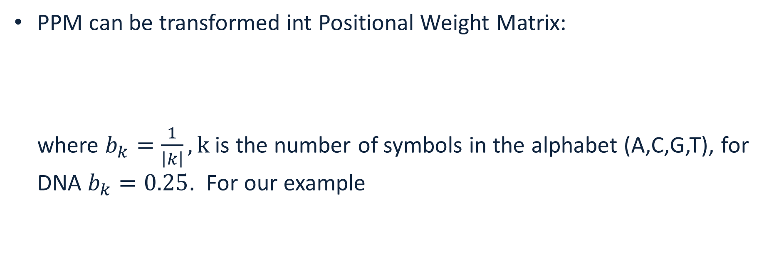

PPM vs PWM
PPM can be transformed int Positional Weight Matrix: where $b_{k}=\frac{1}{\left|k\right|}, k$ is the number of symbols in the alphabet (A,C,G,T), for DNA $b_{k}=0.25$. For our example
$$W_{i,j}=\log_{2}(\frac{P_{i,j}}{b_{k}})$$
$$W_{i,j}=$$

Slide 35

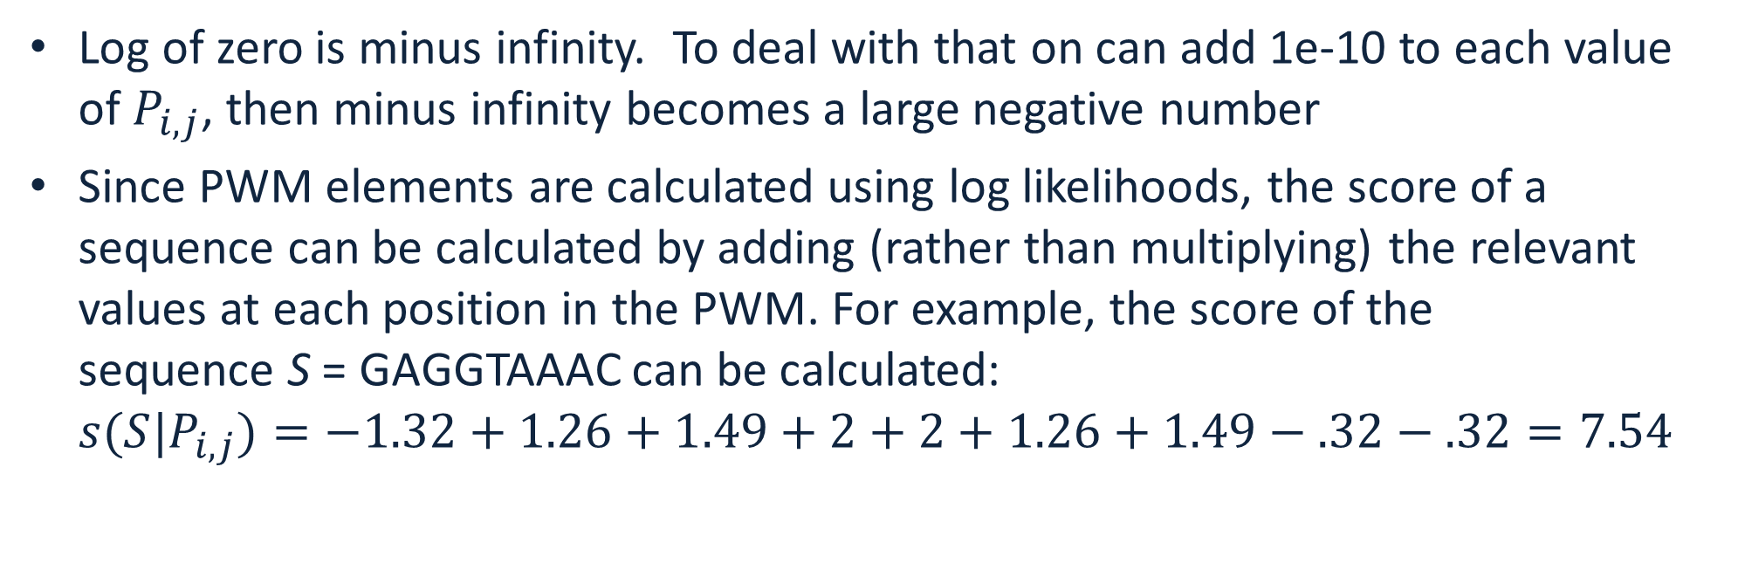
Scoring with PWMs
Log of zero is minus infinity. To deal with that on can add 1e-10 to each value of $P_{i,j}$, then minus infinity becomes a large negative number
Since PWM elements are calculated using log likelihoods, the score of a sequence can be calculated by adding (rather than multiplying) the relevant values at each position in the PWM. For example, the score of the sequence S = GAGGTAAAC can be calculated: ${s(S|P}_{i,j})=−1.32+1.26+1.49+2+2+1.26+1.49−.32−.32=7.54$
$$W_{i,j}=$$

Slide 36
PWM score
The sequence score gives an indication of how different the sequence is from a random sequence (all weights are the same).
The score is 0 if the sequence has the same probability of being a valid pattern (splice site) and of being a random site.
The score is greater than 0 if it is more likely to be a valid splice site than a random site, and less than 0 if it is more likely to be a random site than a valid splice site.
This can be generalized to look or test any feature (donor splice site, acceptor splice site, coding start, coding stop)

Slide 37
Drawback of PWMs
PWMs assume statistical independence between positions in the pattern, as the probabilities for each position are calculated independently of other positions.
This assumption does not match reality for splice site patterns
Longer correlations are present

Slide 38
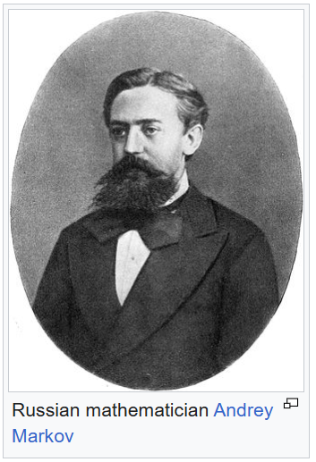
Markov chain
Markov chains allow one to quantify correlations in patterns
Markov chain or Markov process is a stochastic process describing a sequence of possible events in which the probability of each event depends only on the state attained in the previous event.
Informally, this may be thought of as, "What happens next depends only on the state of affairs now."
Markov processes are named in honor of the Russian mathematician Andrey Markov.

Slide 39

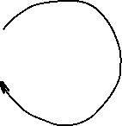

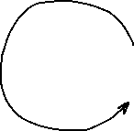
Markov model
Markov model has:
A set of states
Transition probabilities between states
Probabilities of the starting states
Transition probability matrix:
To
B G
From B 0.2 0.8
G 0.5 0.5
Starting probabilities
Pr(B) = 0.6
Pr(G) = 0.4
Markov walk:
BGGBGBGGGBBGBGGGBGGGGB
Outgoing probabilities must sum to 1 !
0.2
0.8
0.5
0.5

Slide 40

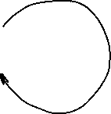

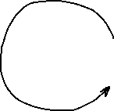
Markov model
For any observed walk we can compute probability that this process generated the walk:
Pr(BGGB)=0.6*0.8*0.5*0.5=0.072
How is this probability useful? We can use it to distinguish between two Markov Processes!
Transition probability matrix:
To
B G
From B 0.2 0.8
G 0.5 0.5
Starting probabilities
Pr(B) = 0.6
Pr(G) = 0.4
0.2
0.8
0.5
0.5

Slide 41
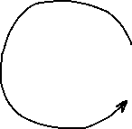

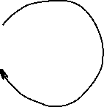
Markov model
Process A Pr(BGGB)=0.6*0.8*0.5*0.5=0.072
Process B Pr(BGGB)=0.5*0.5*0.5*0.5=0.0625
Process A is more likely!
Process A: Starting probabilities Pr(B)=0.6, Pr(G)=0.4
0.2
0.8
Process B: Starting probabilities Pr(B)=0.5, Pr(G)=0.5
0.5
0.5
0.5
0.5
0.5
0.5

Slide 42
Markov chain
We will consider Discrete-time Markov Chains
A discrete-time Markov chain is a sequence of random variables X₁, X₂, X₃, ... with the Markov property, namely that the probability of moving to the next state depends only on the present state and not on the previous states:
Order of the Markov chain is equal to the dimension of the previous state
PPM/PWM is zero-order Markov chain (current state does not depend on previous state

Slide 43


Training Markov chain
Training Markov chain involves estimating transition probability matrix from the data
Consider 1st order Markov chain for a splice site pattern. The probability of the next letter depends only on the previous letter in the pattern
Computation of probabilities is the same as for the PPM, except the alphabet is tuples (“AA”,”AC”,”AG”,”AT”,”CA”,....,”TT”), size=16
Let each tuple be
Compute probabilities for every pair of consecutive letters, for a pattern of length n, the matrix will have dimensions 16 by (n-1)
$$T_{i}$$
$$P_{i,j}^{M}$$

Slide 44
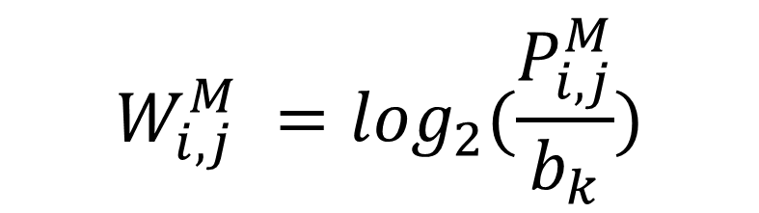
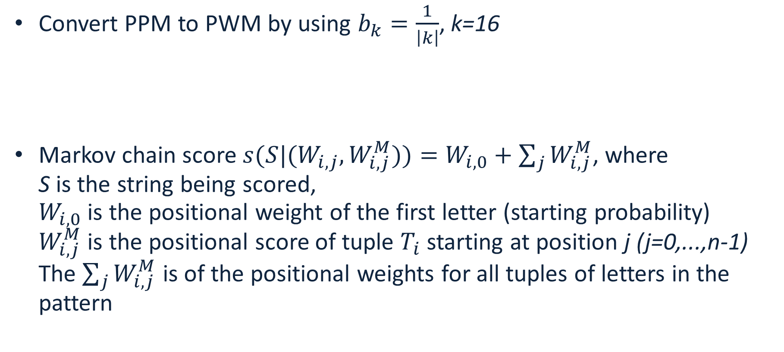
Computing Markov chain probability matrix
Convert PPM to PWM by using $b_{k}=\frac{1}{\left|k\right|}$, k=16
Markov chain score ${s(S|(W}_{i,j},W_{i,j}^{M}))=W_{i,0}+\sum_{j}{W_{i,j}^{M}}$, where S is the string being scored, $W_{i,0}$ is the positional weight of the first letter (starting probability) $W_{i,j}^{M}$ is the positional score of tuple $T_{i}$ starting at position j (j=0,...,n-1) The $\sum_{j}{W_{i,j}^{M}}$ is of the positional weights for all tuples of letters in the pattern
$$W_{i,j}^{M} =\log_{2}(\frac{P_{i,j}^{M}}{b_{k}})$$

Slide 45
Estimation of negative hypothesis
Markov chain score is related to the probability that the Markov process generated the pattern
One should compare it to the negative hypothesis -- score of a randomly chosen pattern
For the negative hypothesis one can compute “negative” Markov chain score using weights computed from genome sequences of length n that are not valid patterns
A reasonable assumption is that for the negative hypothesis all weights are the same
Genomes with strong GC-bias (more G’s and C’s compared to A’s and T’s) fail that assumption

Slide 46
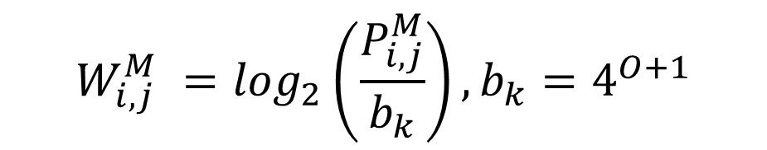
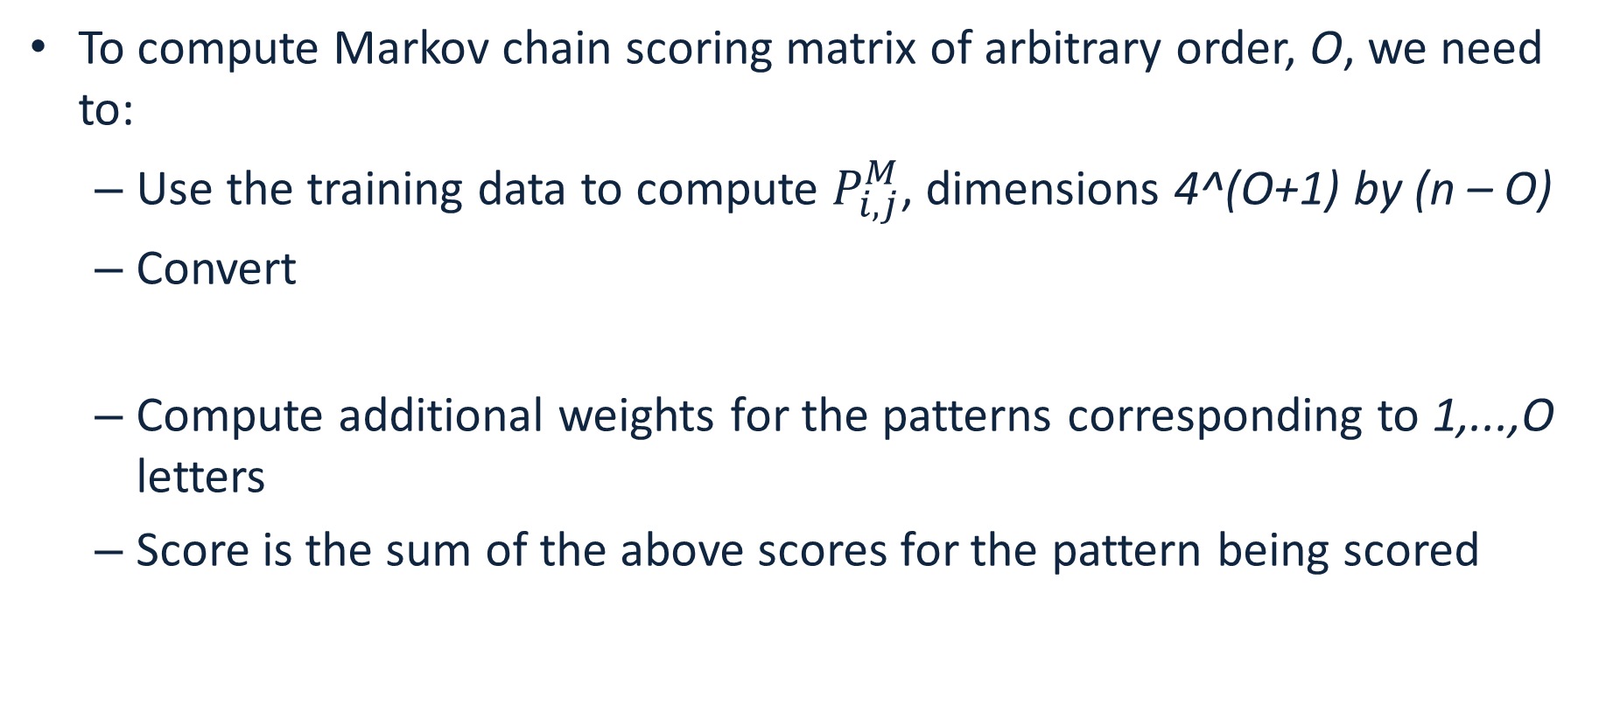
Extend to Markov chain of arbitrary order
To compute Markov chain scoring matrix of arbitrary order, O, we need to:
Use the training data to compute $P_{i,j}^{M}$, dimensions 4^(O+1) by (n – O)
Convert
Compute additional weights for the patterns corresponding to 1,...,O letters
Score is the sum of the above scores for the pattern being scored
$$W_{i,j}^{M} =\log_{2}\left(\frac{P_{i,j}^{M}}{b_{k}}\right), b_{k}=4^{O+1}$$

Slide 47
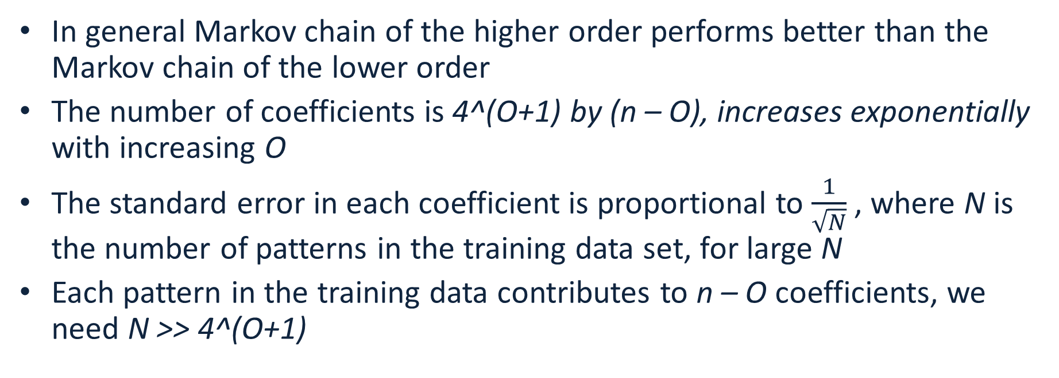
How to choose the order of Markov chain
In general Markov chain of the higher order performs better than the Markov chain of the lower order
The number of coefficients is 4^(O+1) by (n – O), increases exponentially with increasing O
The standard error in each coefficient is proportional to $\frac{1}{\sqrt{N}}$, where N is the number of patterns in the training data set, for large N
Each pattern in the training data contributes to n – O coefficients, we need N >> 4^(O+1)

Slide 48
Hidden Markov Models
Imagine that we cannot observe/measure the states directly, but the states emit data
The goal is to determine the most likely sequence of states given the observed data
0.8
0.2
0.8
0.2

Slide 49
Hidden Markov Models
A Hidden Markov Model is a Markov model that emits data at each state with different probability distributions
Blue state emits data distributed according to probabilities Pb and Green state emits data distributed with probabilities Pg
0.8
0.2
0.8
0.2

Slide 50
The game
Imagine the following game:
One coin is fair: probability of heads or tails is 50%
One coin is biased: probability of heads is 90%
Coins look identical to us (state cannot be observed directly)
The game (repeats N times):
Dealer picks a coin with probability 50% in secret, flips it and makes the result visible
Dealer then switches the coin with probability 20% in secret
Our goal is to guess which coin is used at every toss
0.8
0.2
0.8
Fair (F)
Bias (B)
0.2

Slide 51
Hidden Markov Models
A walk in HMM from the dealer’s perspective: FFBB HTHH
We observe: HTHH
0.8
0.2
0.8
Fair (F)
Bias (B)
0.2

Slide 52
Hidden Markov Models
A walk in HMM from the dealer’s perspective: FFBB HTHH
It is easy for the dealer to compute the probability: Pr(FFBB)=Pr(start in F)*Pr(emit H in F)*Pr(stay in F)* Pr(emit T in F)* Pr(switch to B)* Pr(emit H in B)*Pr(stay in B)* Pr(emit H in B) = 0.5*0.5*0.8*0.5*0.2*0.9*0.8*0.9
0.8
0.2
0.8
Fair (F)
Bias (B)
0.2

Slide 53
Hidden Markov Models
A walk in HMM from the dealer’s perspective: FFBB HTHH
What can we do? Try all possible sequences of 4-letter combinations of F and B, compute probabilities (2^4)
0.8
0.2
0.8
Fair (F)
Bias (B)
0.2

Slide 54
Hidden Markov Models
F
B
F
B
F
B
2^4=16 probabilities,
Pick the guess with the highest probability
Not feasible to do for long runs!!!
F
B
F
B
F
B
F
B
F
B
F
B
F
B
F
B
F
B
F
B
F
B
F
B
0.8
0.2
0.8
Fair (F)
Bias (B)
0.2

Slide 55
Hidden Markov Models
Use Viterbi algorithm for long runs
Input: HMM and the sequence: HHTH…
Output: a state sequence with maximum probability: FFBB…
0.8
0.2
0.8
Fair (F)
Bias (B)
0.2

Slide 56
Gene finding with HMMs
We know the sequence of a genome, how can we find where the coding sequences are? AGAATGGATAGATAGGATAATAATGGGAAATTGATTTAAATTTA --?
The coding/noncoding regions are hidden states (like the coins)
Patterns of letters within coding and noncoding sequences differ
We can use a closely related genome to:
compute patterns for coding/noncoding sequence -- these are our emission probabilities
compute transition probabilities between coding/noncoding states

Slide 57
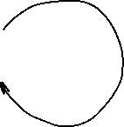

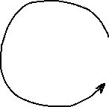
Gene finding with HMMs
Closely related annotated genome: AGAATGGGTAGATAGGATCATAATGGCAAATTGATTTATATTTA
Assume a model:
44 letters, 2 coding->non-coding and 2 non-coding-> coding transitions
Train the model by computing emission probabilities:
Coding: A:9/24, C:1/24, G:8/24, T:6/24
Noncoding: A:8/20, C:1/20, G:2/20, T:9/20
Use Viterbi algorithm to figure out most likely sequence of states (N or C) given the model and emission probabilities; label the letters
21/22
1/22
21/22
Non- coding (N)
Coding (C)
1/22

Slide 58
Viterbi algorithm for HMMs

Slide 59
Variant Calling
Sequencing: A DNA sample is sequenced to generate a large number of short reads containing genetic information.
Alignment: The generated short reads are aligned (mapped) to a known reference genome.
Variant Identification: Bioinformatic algorithms compare the aligned reads to the reference to identify positions where they differ, indicating a variant.
Variant Call Formatting: The identified variants are compiled into a standardized Variant Call Format (VCF) file.

Slide 60
Types of variants
Single Nucleotide Variants (SNVs): A change in a single DNA base pair, such as a single nucleotide polymorphism (SNP).
Insertions/Deletions (Indels): Short segments of DNA that are inserted or deleted.
Structural Variants (SVs): Larger-scale changes to the genome, including deletions, duplications, inversions, and translocations.

Slide 61
Why variant calling is important
Disease Research: Variant calling helps identify genetic mutations associated with various diseases, including cancer.
Clinical Diagnostics: It provides data for diagnosing genetic conditions and understanding individual predispositions to common health problems.
Evolutionary Studies: Comparing variants across populations helps researchers understand evolutionary relationships and genetic diversity.

